Slide 1
Mid Term Presentation Team eXi

Slide 2







Agenda
Introduction
Demonstration
User Testing
X Factor
Technical Complexity
Project Management
Learning Outcomes

Slide 3
1.
Introduction

Slide 4
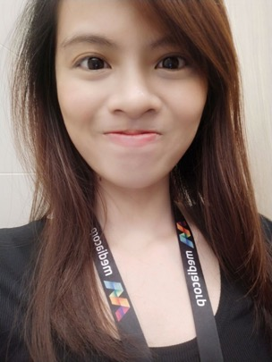

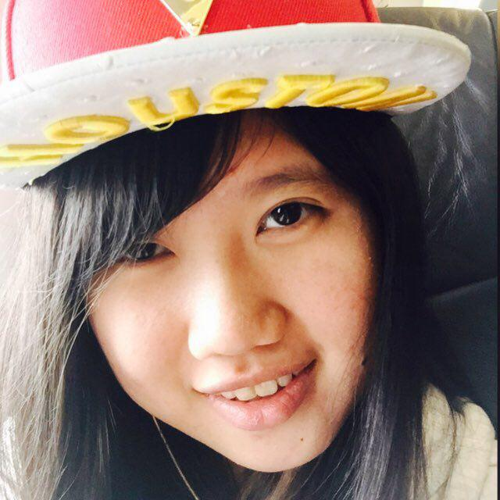
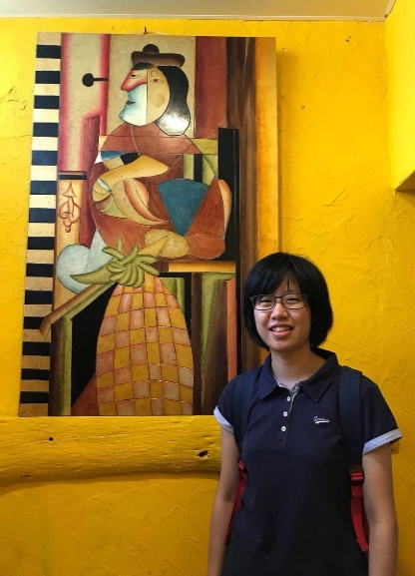

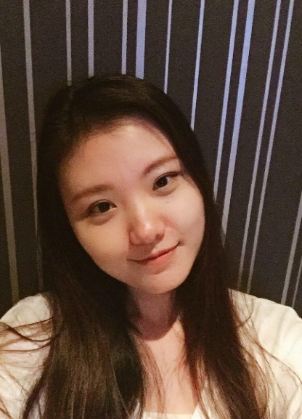
The Team
Hui Xin
Project Manager
Quality Assurance
Moh Moh
Lead Front End Developer
Riana
Lead Back End Developer
Thet Thet
Deputy Back End Developer
Shawn
Deputy Back End Developer
Zang Yu
Deputy Back End Developer

Slide 5



Project Overview
Integrated Web Application
To support operations of the Centre and administrative activities carried out
Facilitate the tracking of performances for parents and provide motivational incentives for students

Slide 6


Stakeholders
Sponsor
Mrs Lian Chee
Principal Instructor
Head, Education Outreach

Slide 7



Motivation
Education sector is a sector we all could relate to
Daily tasks could take up to several hours per day due to the Paper-Based System
Time reduced could be spent on more value adding tasks such as restructuring of curriculum

Slide 8
2.
Demonstration

Slide 9
3.
User Testing

Slide 10
Objectives
Gather feedback regarding Interface Design and Navigation Flow
Gauge user’s comfortability & satisfaction with the UI and functionalities implemented
Improve the Portal based on feedbacks and comments received

Slide 11




User Testing 1
Account Module
Admin Module
Student Mgmt Module
Grades Module
Stepping Stones Learning Centre, Bukit Panjang Branch
28 July 2018, Saturday
2:30 pm – 3:30 pm
2

Slide 12
Issues
Trouble with navigating due to the naming of navigation bars

Slide 13
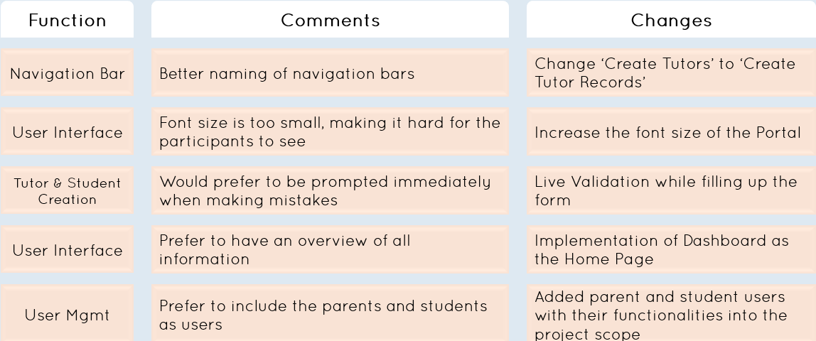
Action Taken

Slide 14
User Testing 2
Attendance Module
Grades Module
Schedule Module
Stepping Stones Learning Centre, Bukit Panjang Branch
8 September 2018, Saturday
2:30 pm – 3:30 pm
2

Slide 15
Issues
Layout of Attendance Taking Interface not intuitive enough
Confusing label specifying grade but input field is limited to raw score

Slide 16
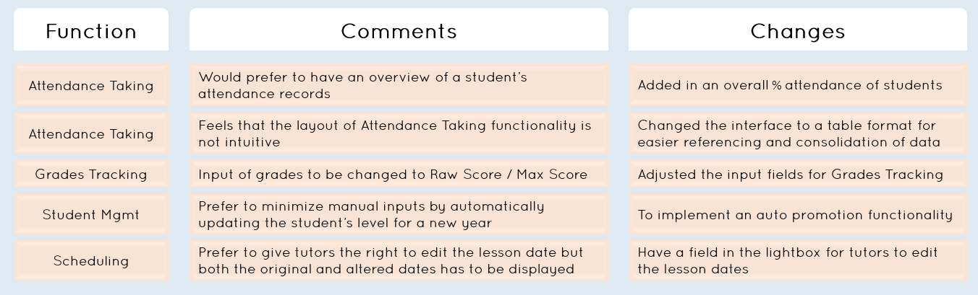
Action Taken

Slide 17
User Testing 3
Student Mgmt Module
Admin Module
Attendance Module
Grades Module
Schedule Module
Stepping Stones Learning Centre, Bukit Panjang Branch
22 September 2018, Saturday
2:30 pm – 5:00 pm
2

Slide 18
Issues
Confusion over what happens after the creation of Branch Admins
Could not remove multiple levels for Edit Subject at once
Unable to locate the editing functionalities

Slide 19
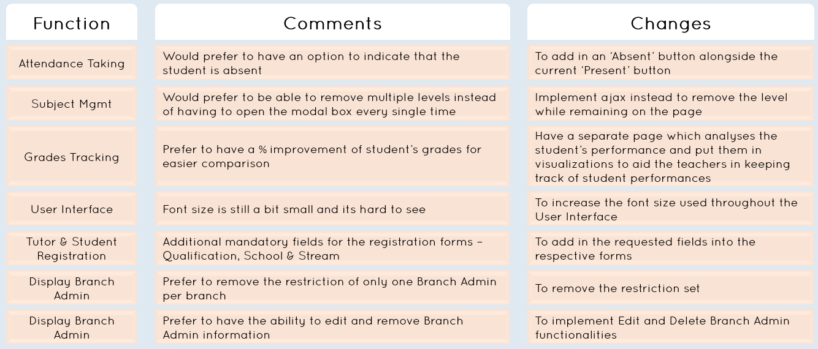
Action Taken

Slide 20
4.
X Factor

Slide 21
X Factor
Mid Term
Conduct Pilot Testing with the Centre on 2 classes of 10 students and 1 tutor
Reduction in time taken to complete daily administrative tasks for an estimated of 30 – 40%
Final

Slide 22

Pilot Testing
We are currently having a Pilot Test with the entire branch consisting of 3 branch admins, 4 tutors and 61 students, starting on 28/09/18

Slide 23
Overview
Pilot Testing Period
29 Oct 2018 – 27 Nov 2018
Participants
3 Branch Admins
4 Tutors
61 Students
17 Classes
Scope
Account Module
Admin Module
Student Mgmt Module
Grades Module
Attendance Taking Module
Scheduling Module

Slide 24
Feedbacks
Certain classes consists of students of varying levels (E.g Sec 3 and Sec 4 English classes are combined) but the scheduling functionality does not cater to this.
Unable to edit attendances once marked
Optional details could not be entered on registration. Instead, had to create the student then navigate to edit the student information
Restriction on mobile number for Student Registration does not take into account home number
Portal does not work well on Internet Explorer
Tutor Account Creation emails are sending out the wrong usernames

Slide 25
Rectification
Feedback
Unable to edit attendance once marked
Can’t enter additional detail field for student registration
Portal does not work well on IE
Sending email wrongly
Action
Added absent and present to edit again
Will be adding option fields and will only appear when the user want to add optional
We will make the browser combability by investigating and modifying css and javascript code that cause error
We will be testing more users account to check the right people receive the right email

Slide 26
4.
Technical Complexity

Slide 28
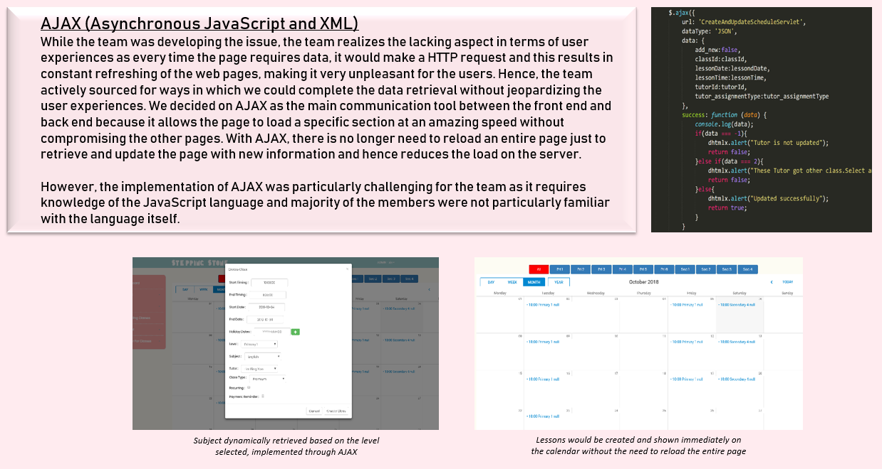

Slide 29
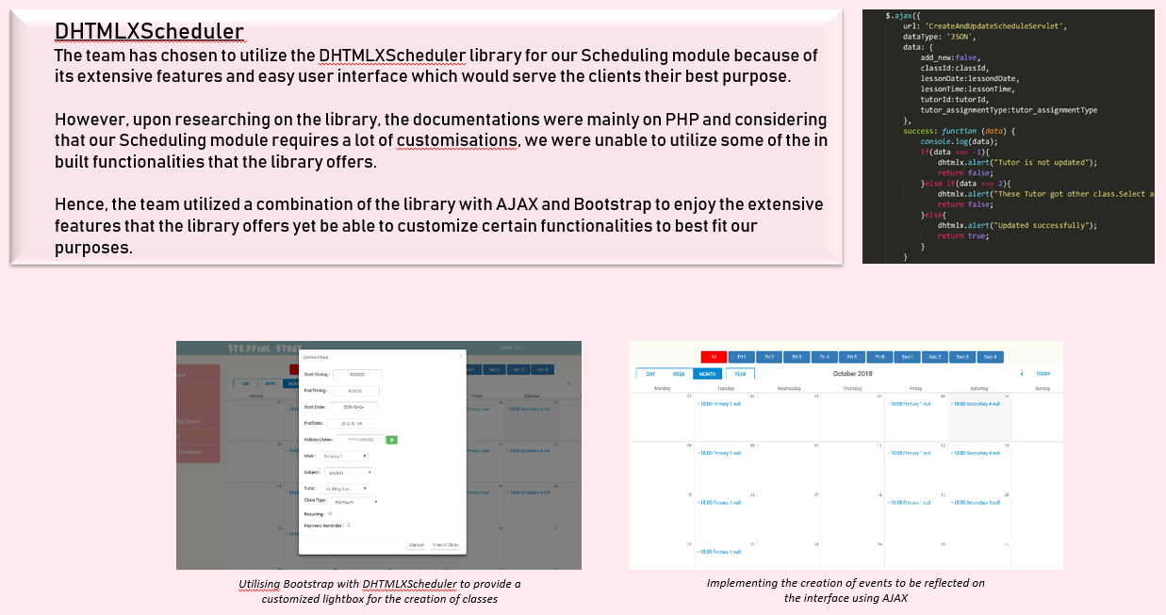

Slide 30
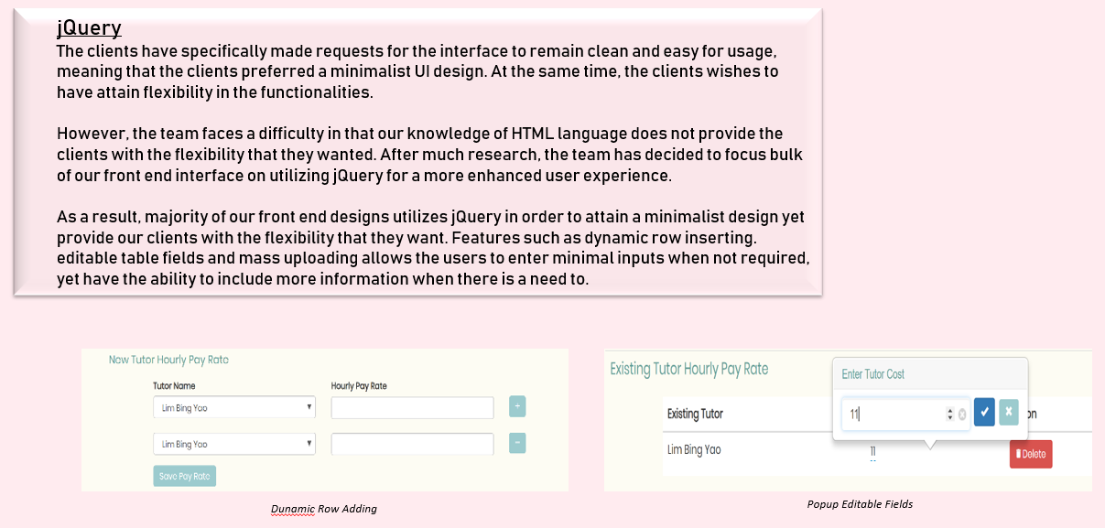

Slide 31
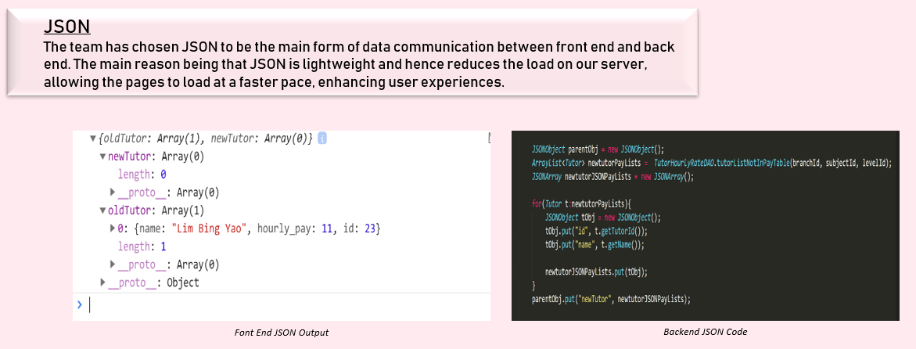

Slide 32
5.
Project Management

Slide 33
CORE
SECONDARY
TERTIARY
Accounts Module
Profile Mgmt
Login/Logout
Reset Password
Admin Module
Access Control
Admin Mgmt
Branch Mgmt
Subject Mgmt
Receipts Module
Pay Slip Generation
Invoice Generation
Rewards Module
Creation of reward points
Updating of reward points
Reading of reward points
Financial Module
Exporting
Updating
Writing
Viewing
Calculations
Dashboard Module
Summary of Financial
Report
Late Payments List
Replacement Classes List
Class Listing
Weekly Lesson Schedule
Number of Classes
Number of Branches
Number of Students
Number of Tutors
Schedule Module
Creation
Updating
Viewing
Grades Module
Grades Modification
Adding of Grades
Grades Viewing
Student Mgmt Module
Creation
View
Update
Delete
Mass Upload
Tutor Mgmt Module
Creation
View
Delete
Update
Mass Upload
Attendance Module
Creation of Tutor & Student Attendance
Reading of Tutor & Student Attendance
Updating of Tutor & Student Attendance
Search Module
Search Students
Search Tutors
Search Reports (By month, By year)
Payment Module
Tracking
SMS Reminders
Parent Mgmt Module
Creation
View
Update
Acceptance

Slide 34
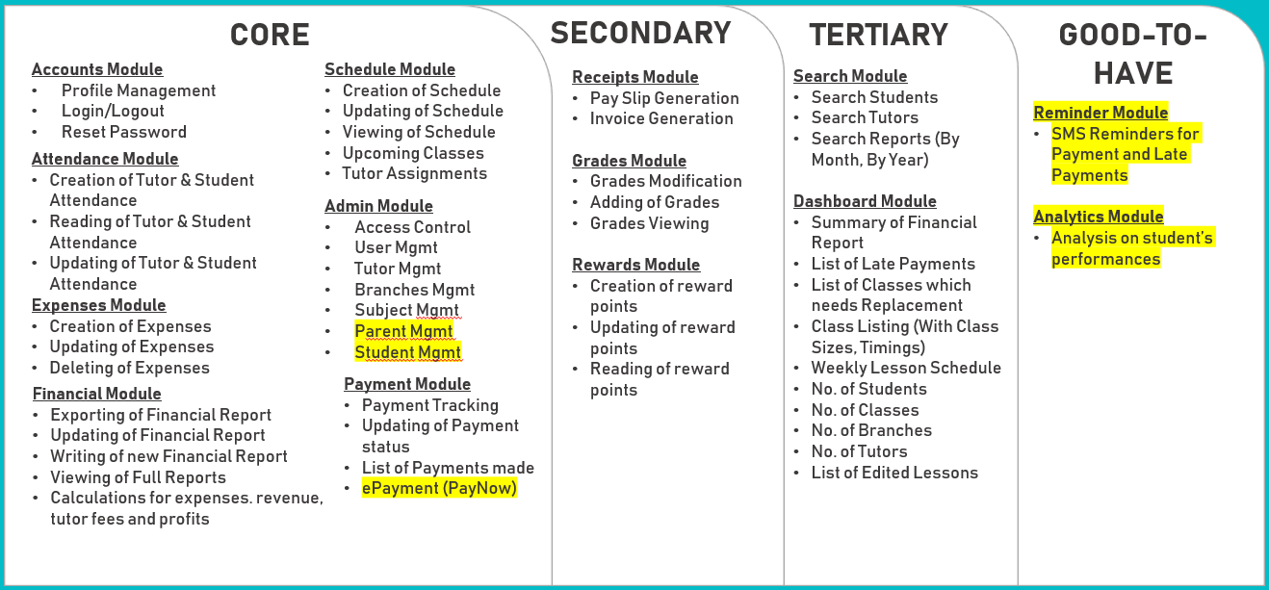
Since Acceptance

Slide 35
35
Iteration 0
6 Jun – 20 Jun
Iteration 1
21 Jun – 4 Jul
Iteration 2
5 Jul – 19 Jul
Iteration 3
20 Jul – 3 Aug
Milestone: Proposal Submission
Requirements Gathering
Technical Research
Logo Design
Roles Assignment
Proposal Preparation
Design ER Diagram
Use Case Diagram
Sequence Diagrams
Firebase Database Setup
UI Design
Class Diagram
Wiki Update
Wiki Update
Test Cases Design
Accounts Module
Creation of Entity Classes
Firebase Configurations
Home Page
Login/Logout
Reset Password
Admin Module
Tutor Mgmt
Student Mgmt Module
Creation (Sign Up)
Updating
Wiki Update
Test Cases Design
Architecture Diagram
Process Diagrams (As-Is & To-Be)
ConnectionManager
Conversion of DAO to call API
Classes Module
Creation of Class entity
Grades Module
Grades CRUD
Supervisor Meeting
Sponsor Meeting
User Testing

Slide 36
Iteration 4
4 Aug – 17 Aug
Iteration 5
18 Aug – 1 Sep
Iteration 6
2 Sep – 16 Sep
Iteration 7
17 Sep – 1 Oct
Milestone: Acceptance
Acceptance Preparation
Wiki Update
Test Cases Design
Accounts Module
Login Authentication
Email for Password Reset
Dashboard Module
No. of students
No. of tutors
No. of branches
No. of classes
Schedule Module
Classes CRUD
Admin Module
Subject CRUD
Admin CRUD
Branch CRUD
Student Class Registration
Grades Module
Grades CRUD
User Testing
Supervisor Meeting
Wiki Update
Test Cases Design
View Details for all
Schedule Module
Restructuring of Creation & Update
Payment Tracking Module
Payment SMS Reminders
Attendance Taking Module
Students & Tutors Attendance Taking
Supervisor Meeting
Wiki Update
Test Cases Design
Low Fid Wireframe
Schedule Module
Admin Scheduling UI
Tutor Scheduling UI
Grades Module
Grades Interface
Attendance Taking Module
Attendance Taking UI
Student Mgmt Module
Student Registration UI
Admin Module
Tutor Registration UI
User Testing
Sponsor Meeting
Supervisor Meeting
Mid Term Preparation
Wiki Update
Test Cases Design
Schedule Module
Admin Scheduling UI
Admin Module
Subject Deleting
Student & Tutor Registration UI
Grades Module
Display Grades UI
Payment Tracking Module
Student & Tutor Payment Tracking
Payment status update
Attendance Taking Module
Attendance Taking UI
User Testing
Supervisor Meeting
Sponsor Meeting

Slide 37
Iteration 8
2 Oct – 16 Oct
Iteration 9
17 Oct – 31 Oct
Iteration 10
1 Nov – 15 Nov
Iteration 11
16 Nov – 27 Nov
Milestone: Poster Submission
Wiki Update
Test Cases Design
Poster Preparation
Payment Tracking Module
ePayment - PayNow
Search Module
Search Tutors
Search Students
Search Reports
Dashboard Module
Latest Pay Details
Latest Grade Details
Overdue Payments
Financial Report Summary
Latest Report Updates
Late Payment List
Supervisor Meeting
User Testing
Wiki Update
Test Cases Design
Final Presentation Preparation
Reward Module
Points CRUD
List of redemptions available
Grades Module
Analysis & Comparison of Student Performances
Dashboard Module
Poor performing students list
Accumulated points
Recent redemption details
Supervisor Meeting
Sponsor Meeting
Milestone: Final Presentation
Wiki Update
Final Presentation Preparation
UI Enhancement
Web Responsive UI
Supervisor Meeting
Milestone: Mid Term
Wiki Update
Test Cases Design
Receipt Module
Receipt Generation
Payslips Generation
Expenses Module
Expenses UI
Expenses CRUD
Financial Report Module
Scheduler for Report Generation
Store reports in Jelastic
Dashboard Module
Changes to lesson dates by Tutor
Attendance Taking Module
View Attendances (Student & Parent)
Grades Module
View Grades (Student & Parent)
User Testing

Slide 38
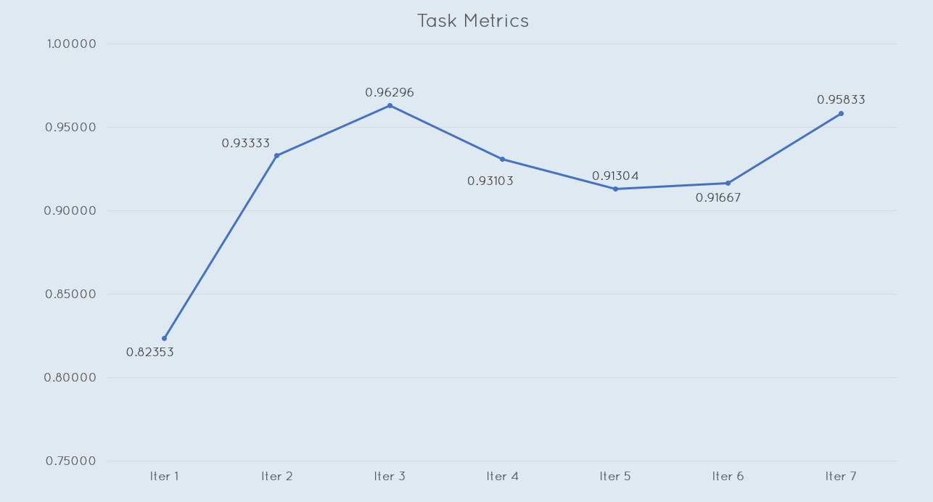
Task Metrics

Slide 39
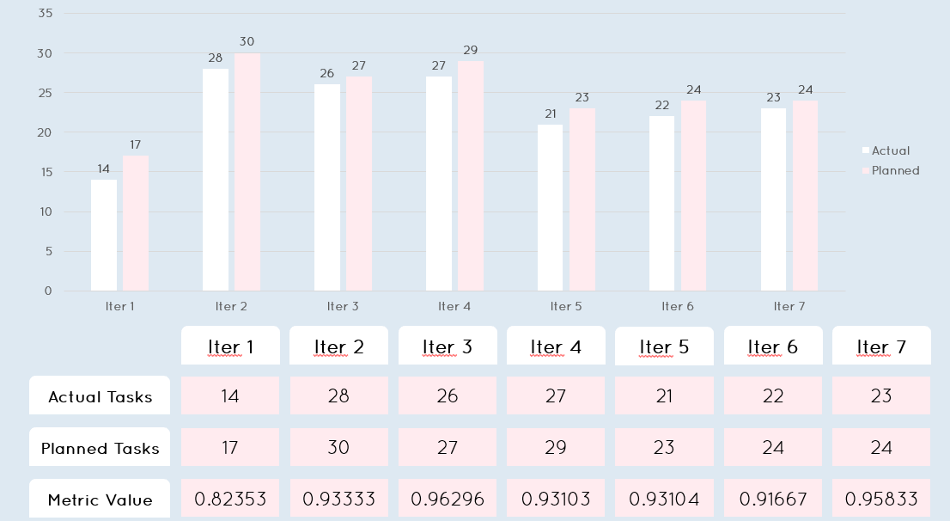
Task Metrics

Slide 40
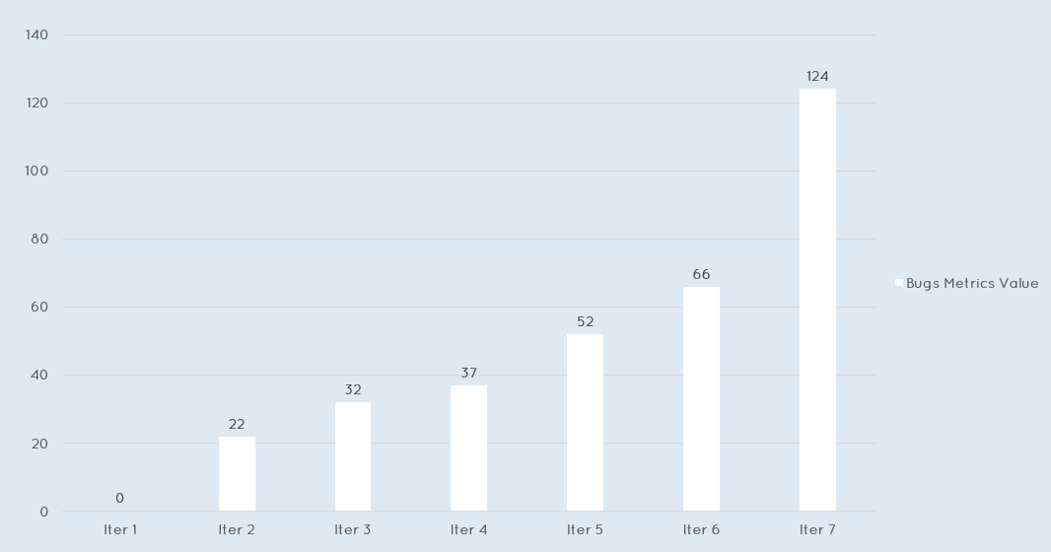
Bug Metrics

Slide 41
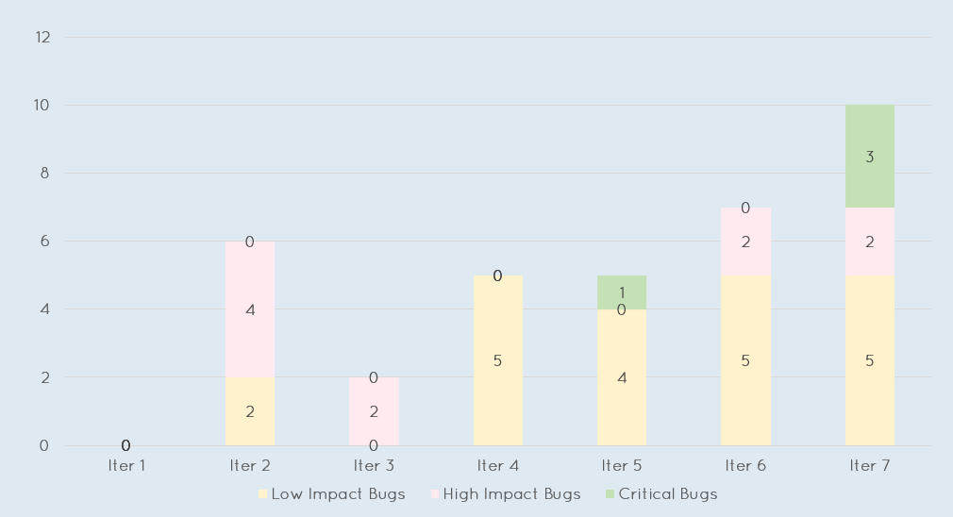
Bug Metrics

Slide 42
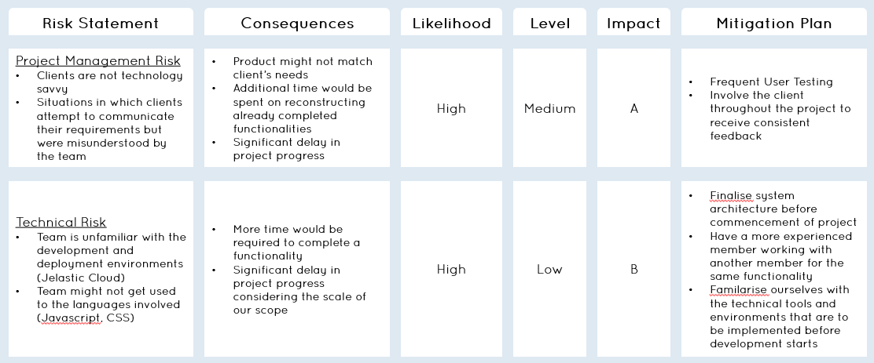
Risk Management

Slide 43
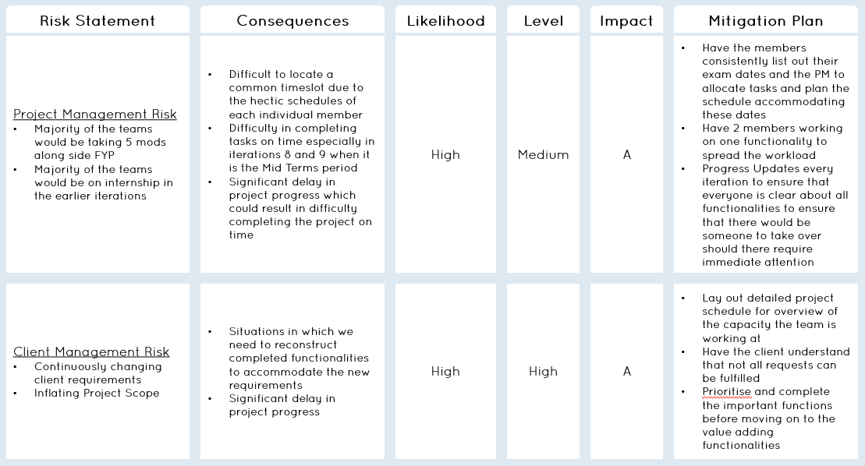
Risk Management

Slide 44
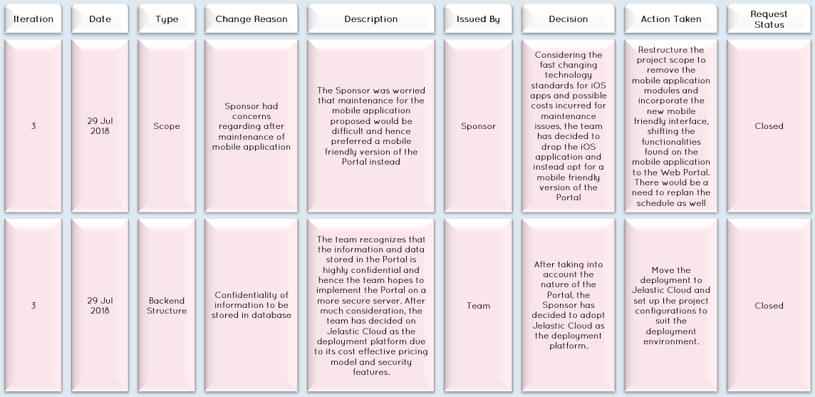
Change Management

Slide 45
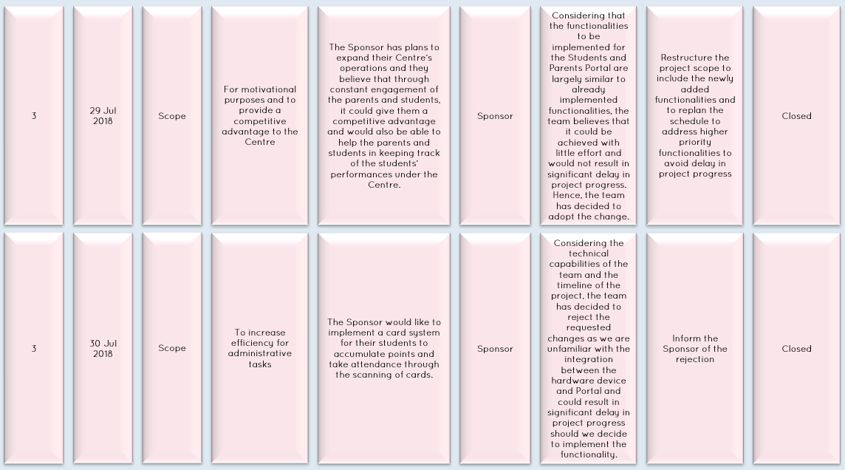
Change Management

Slide 46
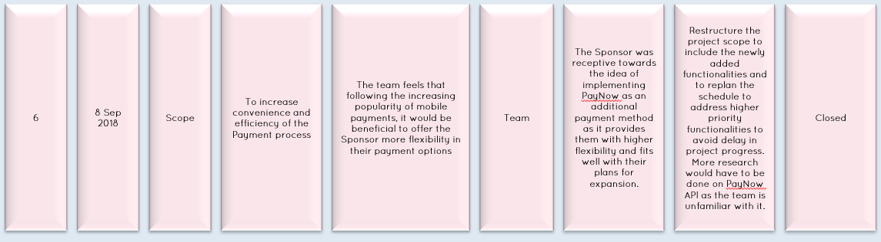
Change Management

Slide 47
8.
Learning Outcomes

Slide 48
Hui Xin
As the Project Manager, I have realized the importance of planning ahead. In the earlier iterations, it was during Summer Break and hence there were not many issues with clashing schedules. However, as school starts and all of us taking different mods, it is getting increasingly difficult to arrange for meetings. In addition, with the workload of other mods and exams, more efforts are required for the delegating of work to ensure my members could balance FYP and other mods without compromising on either.
In addition, this is actually the first time I have participated in the Front End developing and I have learnt a lot, ranging from how to source and utilize libraries as well as how to design an interface that would best suit the needs of our clients.

Slide 49
Moh Moh
The project till now has gave me many knowledge on User Experiences which I had vague knowledge before. An example would be the issue of the page always refreshing upon the completion of a single action. When designing, I did not take that into account and upon testing and receiving feedbacks from the actual users, I actually learnt how to design with the users in mind.
In addition, I realise the importance of time management more as I progress further into the iterations as there is a need for proper time management so I could juggle my other mods together with FYP.

Slide 50
Riana
As a lead back-end developer, I have gained experience working with our client. Most importantly, I have gained experience in understanding and implementing the system based on client's requirement so that we can deliver a solid system to our client.
Besides, as a member of the team, I have learnt to work as a team, and gain knowledge from the rest of the team while I also share the knowledge I have.

Slide 51
Shawn
With 5 mods including fyp as well as two sports competitions has made me very pressed for time. However, it better taught me how to manage and plan my time. It has also taught me how to better work in a team, not to overpromise deadlines for example.
Through this project I have also improved my coding proficiency and expanded my knowledge on languages.

Slide 52
Thet Thet
As a Back End Developer, I work a lot with coding logic and technical implementations. Certain frameworks or libraries are foreign to me and I have to familarise myself with those technical tools in the shortest time possible due to our tight schedule. Hence, consistent learning throughout development and time management became my key takeaways from this project, aside from all the new technical knowledge.

Slide 53
Zang Yu
Time management was one of the most important takeaways from the project for me till date as I am juggling between 4 other mods and FYP. There is a need for me to be able to maintain my grades yet not compromise on my quality of work and quantity of contribution to the team.
In addition, this is my first time working as a Front End Developer and it has made me gain many insights on how to design a clean interface which would be comfortable to the users and how to design with the users in mind.

Slide 54
Thank you!

